Slide 1
Computer vision and Deep Learning
Lecture 6: Sequences. Recurrent neural networks. Transformers (I).
BORZA DIANA LAURA

Slide 2
Today’s agenda
Sequence models
Recurrent neural networks
Transformers

Slide 3
Sequence models

Slide 4
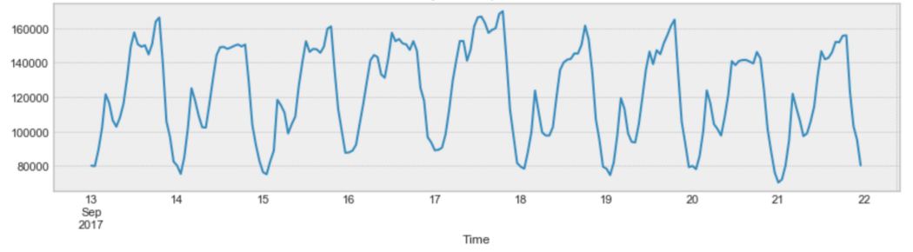
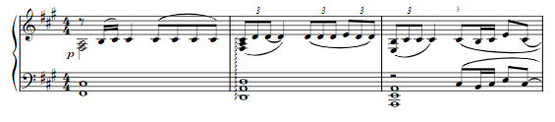
Sequences
Numerical: time series (1d), nd
Categorical: characters, words, music keys etc.
T,h,e,r,e, ,w,a,s, ,a
There, was, a,

Slide 5
Sequence models
Sequence models are applied on sequences of different lengths using the same (shared weights)
Input sequence
Output: label (classification), number (regression), token, sequence

Slide 6
Sequence to sequence layers
Input: sequence of vectors
Output: sequence of vectors
Sequence to sequence layers can be applied on input sequences of different lengths (but using the same weights).
Sequence to sequence layers:
Recurrent neural networks
Convolutions
Self-attention layers

Slide 7
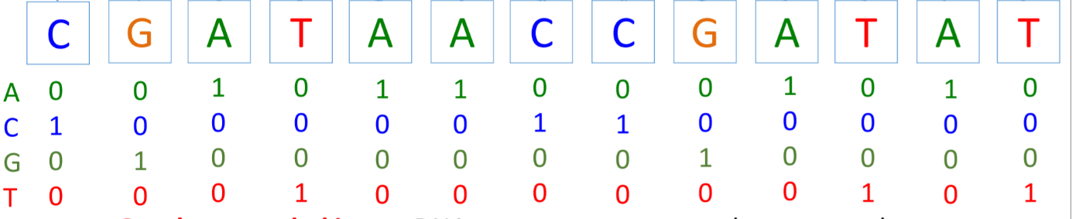
Processing discrete inputs
One hot encoding

Slide 8
Processing discrete inputs
Combined in some learning tasks and learned by back-propagation
Embedding: given a set of discrete values x_{i} ∈ X, model them by an embedding vector emb[x_{i}], such that if x_{i} and x_{j} are similar, so are emb[x_{i}] and emb[x_{j}]

Slide 9
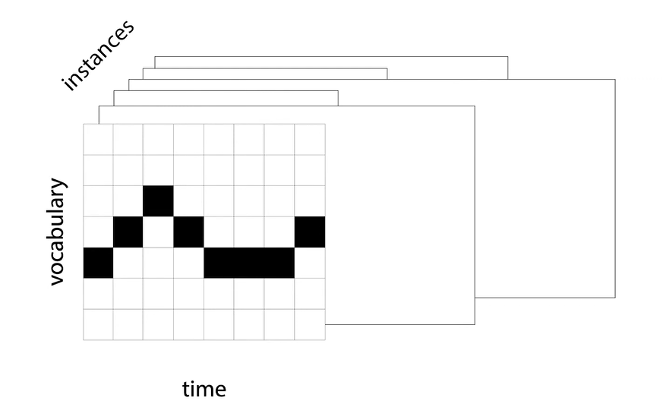
Batching sequences
Padding

Slide 10
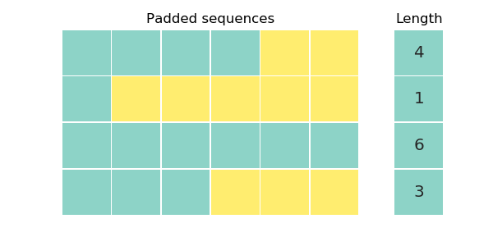
Batching sequences: padding

Slide 11
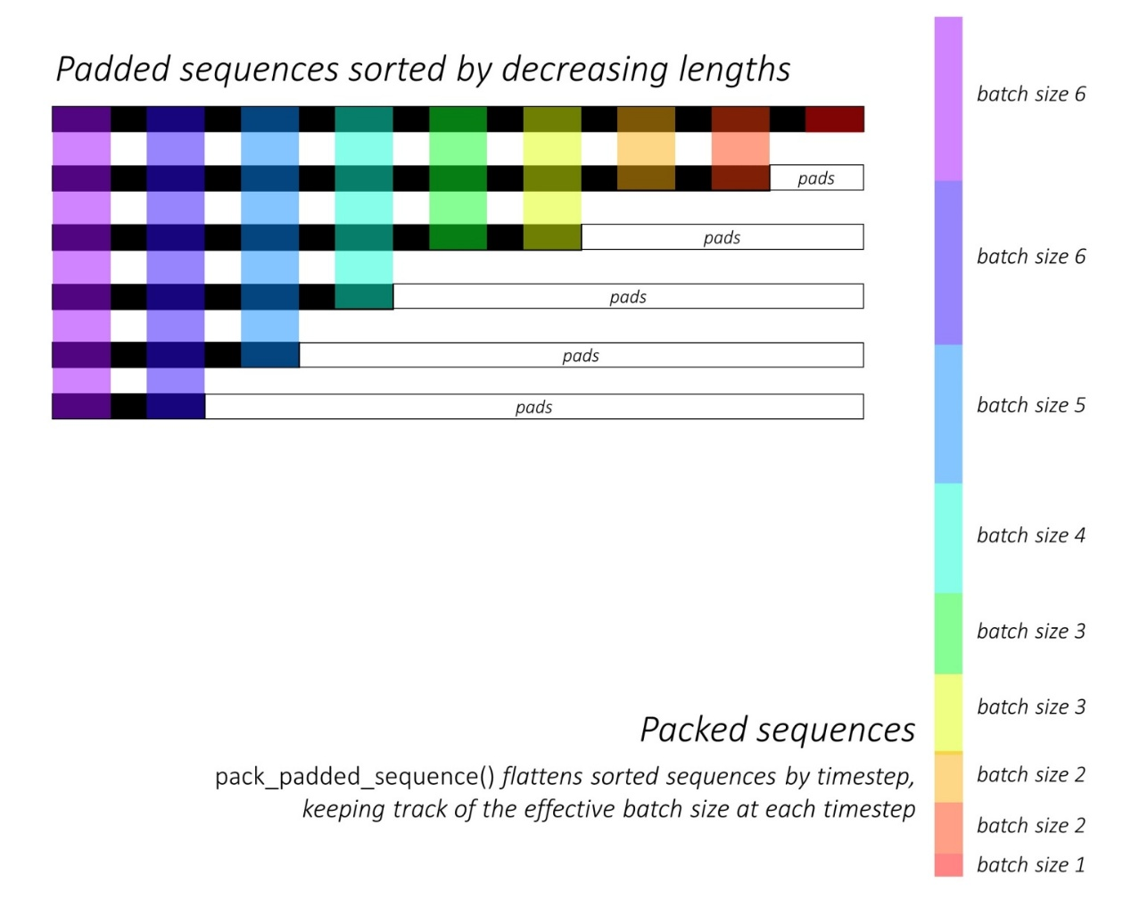
Batching sequences: packing
You can use lengthwise sorting and use a dynamic batch size

Slide 12
Definitions
Casuality: the way the elements in a layer are wired up
Casual layer: element x_{i} has access only to elements x₀, x₁, …, x_{i-1}

Slide 13
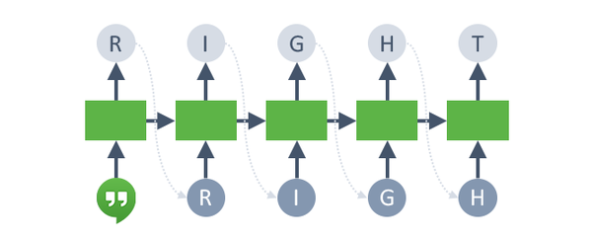
Definitions
Autoregressive model
Start with a seed (a few samples): [t0, t1]
Sample the next token t = 2 from P(t | t0, t1) and append it to the sequence
Feed the sequence to the network
REPEAT

Slide 14
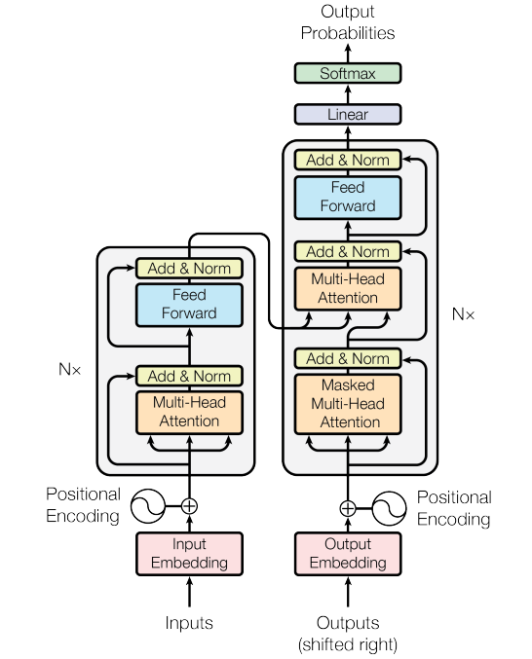
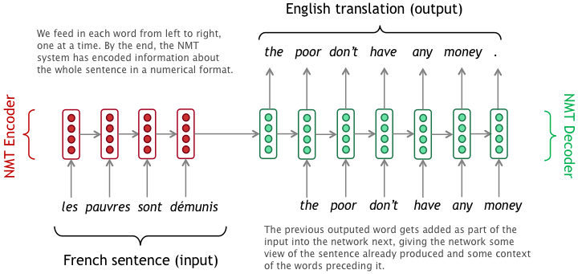
Definitions
Teacher forcing
Scheduled sampling: “probabilistic schedule”
https://medium.com/@vivekvscool/translation-or-answer-tool-seq2seq-with-teacher-forcing-and-attention-mechanism-7cfd9cb03b3a

Slide 15
Patterns in sequence models

Slide 16
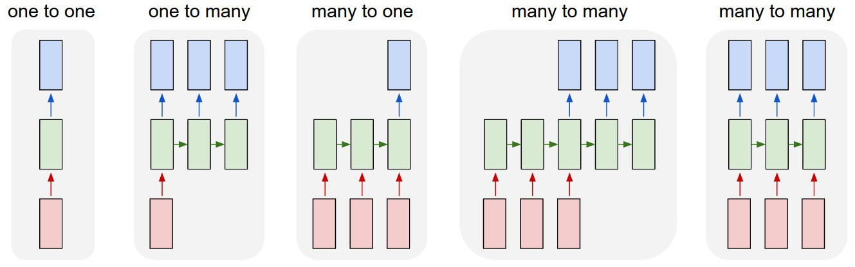
Process sequences

Slide 17
Process sequences
Image captioning,
Text generation

Slide 18
Process sequences
Action recognition
Sentiment classification

Slide 19
Process sequences
Video classification at frame level
Text translation

Slide 20
Recurrent neural networks

Slide 21
Recurrent neural networks
A recurrent neural network is a network where we can have a cycle between two nodes
y^{<t>}
RNN cell h^{<t>}
x^{<t>}

Slide 22
RNN cell
Recurrent core cell
Input: x^{<t>}
Internal hidden state: h^{<t>}
updated each time an input x^{<t>} is fed to the cell
Output: y^{<t>}
at some time steps
y^{<t>}
RNN cell h^{<t>}
x^{<t>}

Slide 23
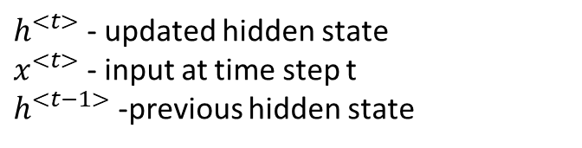

RNN cell
$$h^{<t>} =f_{W}(h^{<t−1>},x^{<t>})$$
$h^{<t>}$ - updated hidden state
$x^{<t>}$ - input at time step t
$h^{<t−1>}$ -previous hidden state
y^{<t>}
RNN cell
x^{<t>}

Slide 24

RNN cell
$$h^{<t>} =f_{W}(h^{<t−1>},x^{<t>})$$
$h^{<t>}$ - updated hidden state
$x^{<t>}$ - input at time step t
$h^{<t−1>}$ -previous hidden state
y^{<t>}
RNN cell
$$h^{<t>}=tanh⁡(W_{h}h^{<t−1>}+W_{x}x^{<t>})$$
x^{<t>}
nonlinearity

Slide 25

RNN cell
$$h^{<t>} =f_{W}(h^{<t−1>},x^{<t>})$$
$h^{<t>}$ - updated hidden state
$x^{<t>}$ - input at time step t
$h^{<t−1>}$ -previous hidden state
y^{<t>}
RNN cell
$$h^{<t>}=tanh⁡(W_{h}h^{<t−1>}+W_{x}x^{<t>})$$
x^{<t>}
$y^{<t>}$ : make a decision based on $h^{<t>}$ each time step
$$y^{<t>}=W_{y}h^{<t>}$$

Slide 26


RNN cell
y^{<1>}
$$y^{<1>}=W_{y}h^{<1>}$$
RNN cell
h^{<1>}
$$h^{<1>}=tanh⁡(W_{h}h^{<0>}+W_{x}x^{<1>})$$
h^{<0>} = [0, .., 0]
x^{<1>}
x^{<2>}
x^{<3>}

Slide 27


RNN cell
y^{<1>}
y^{<2>}
RNN cell
$$y^{<2>}=W_{y}h^{<2>}$$
h^{<2>}
$$h^{<2>}=tanh⁡(W_{h}h^{<1>}+W_{x}x^{<2>})$$
h^{<1>}
x^{<1>}
x^{<2>}
x^{<3>}
x^{<4>}

Slide 28


RNN cell
y^{<1>}
y^{<2>}
y^{<3>}
RNN cell
$$y^{<3>}=W_{y}h^{<3>}$$
h^{<3>}
$$h^{<3>}=tanh⁡(W_{h}h^{<2>}+W_{x}x^{<3>})$$
h^{<2>}
x^{<1>}
x^{<2>}
x^{<3>}
x^{<4>}
x^{<5>}

Slide 29
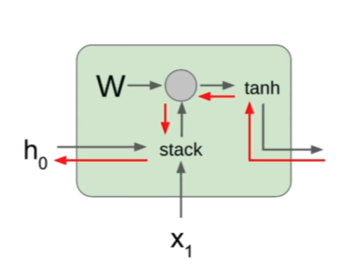
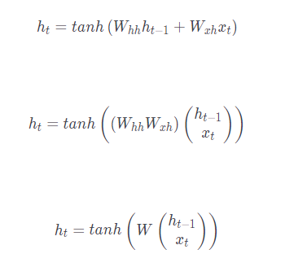
RNN backward pass
During backpropagation from the next state to the current state we pass through a matrix multiplication step

Slide 30
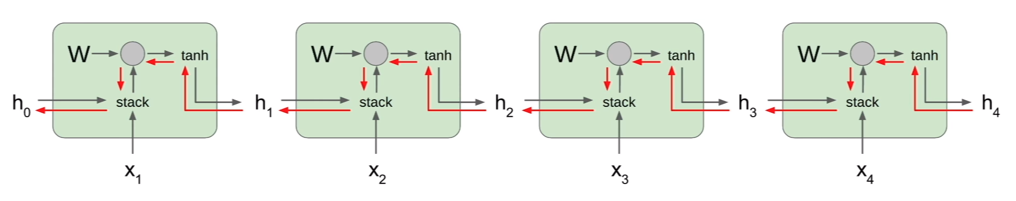
RNN backward pass
At each cell we multiply by many factors of the weight matrix W
> 1: exploding gradients (gradient clipping): scale the value of the gradient if it is too big
< 1: vanishing gradients

Slide 31
Long short term memory
https://colah.github.io/posts/2015-08-Understanding-LSTMs/

Slide 32
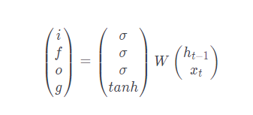


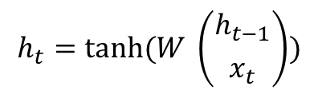
Long short term memory, 1997
Alleviate the problems of vanishing and exploding gradient
Selective forgetting and remembering (gates)
RNN
LSTM
$$h_{t}=tanh⁡(W \left({h_{t−1} \atop x_{t}}\right))$$
Two hidden states:
c – cell state
h – hidden state

Slide 33
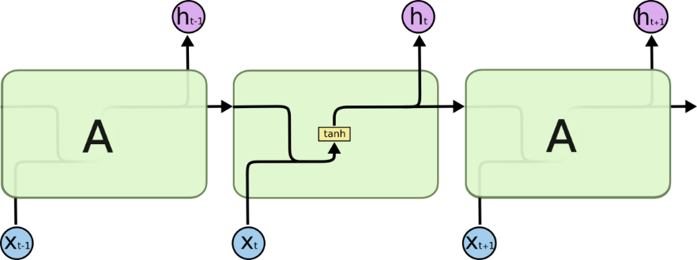
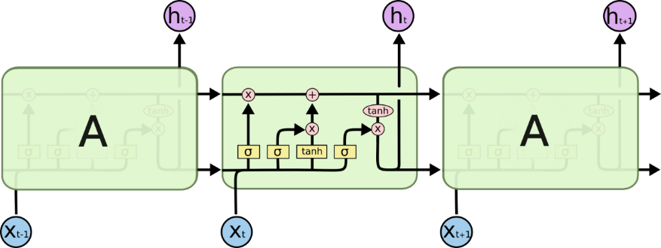
Long short term memory, 1997
Alleviate the problems of vanishing and exploding gradient
RNN LSTM
Two hidden states:
c – cell state
h – hidden state

Slide 34
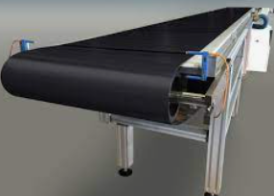
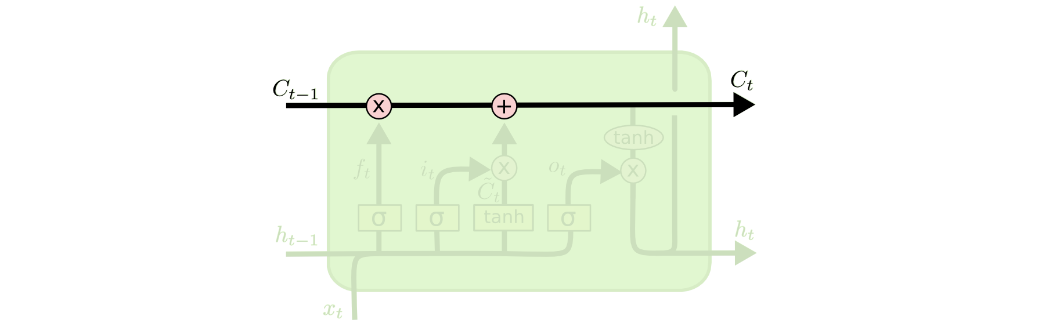
Long short term memory
Conveyor belt: previous cell state passes to become the next cell state with only some minor linear interactions

Slide 35
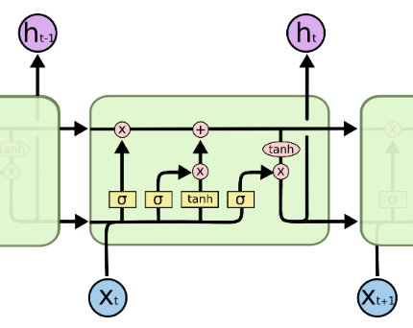
Long short term memory
Concatenate previous hidden state cell with the current input and multiply them with a bigger weight matrix to compute four gates

Slide 36
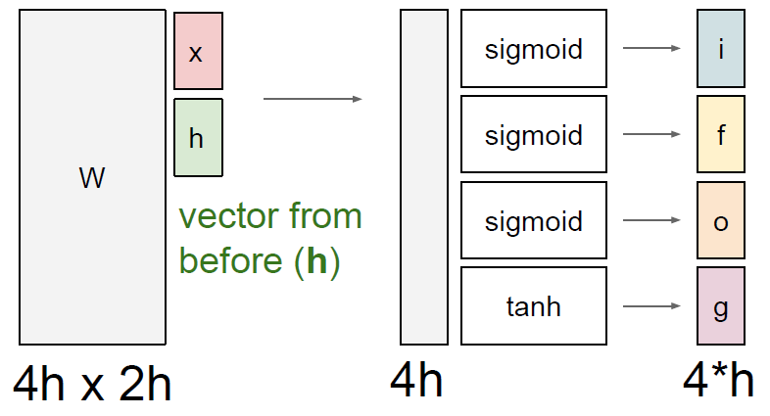
LSTM cell

Slide 37
Long short term memory
forget gate: whether to erase cell (how much we want to forget from the previous cell state?)
input gate: whether to write to cell (how much to input into our cell?)
g gate: how much to write to cell (how much to write into our cell?)
output gate: how much to reveal cell (how much to reveal from ourselves to the outside?

Slide 38
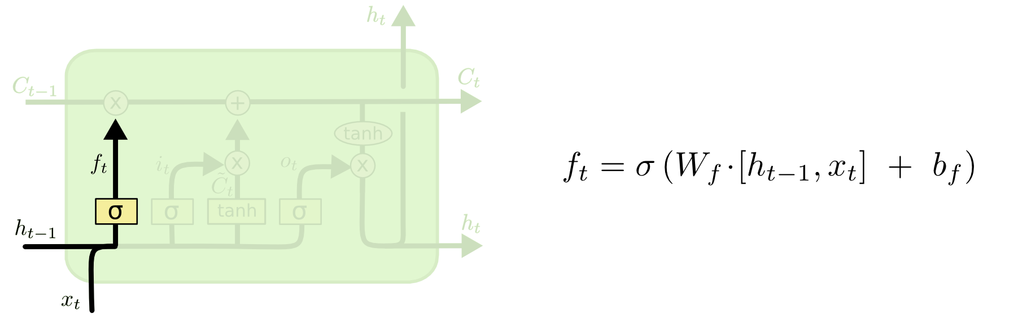
Long short-term memory Forget gate: how much we want to forget from the previous cell state?/ whether to erase the cell
Sigmoid: [0, 1]
tanh: [-1, 1]
Element wise multiplication: forget that element of the cell (0), or remember it (1)

Slide 39
Long short-term memory Forget gate: how much we want to forget from the previous cell state?/ whether to erase the cell
Intuition: “The cell state might include the gender of the present subject, so that the correct pronouns can be used. When we see a new subject, we want to forget the gender of the old subject.”
Next, we need decide what new information we’re going to store in the cell state.
a sigmoid layer called the “input gate layer” decides which values we’ll update
a tanh layer (g gate) creates a vector of new candidate values, that could be added to the state
https://colah.github.io/posts/2015-08-Understanding-LSTMs/

Slide 40
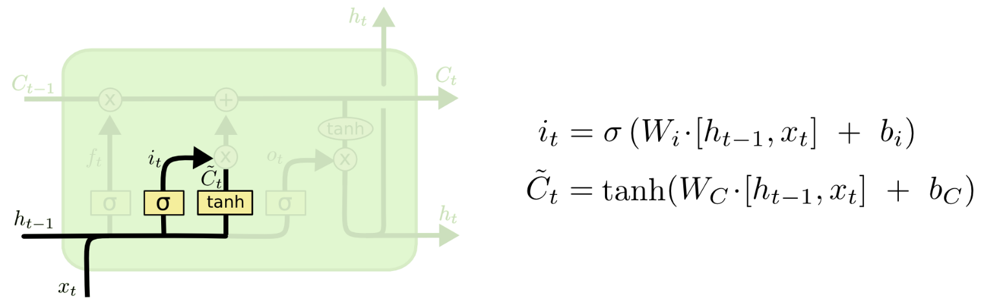
Long short-term memory Input gate: how much to input into our cell? / whether to write to cell
Sigmoid: [0, 1]
tanh: [-1, 1]
Element wise multiplication: for each element of the cell state, do we want to write to (1) it or not (0)?

Slide 41
Long short-term memory Input gate: how much to input into our cell? / whether to write to cell g gate: how much to write to cell (how much to write into our cell?)
Sigmoid: [0, 1]
tanh: [-1, 1]
Element wise multiplication: the candidate value that we might consider writing to the current cell state [-1, 1] (creates a vector of new candidate values, that could be added to the state)

Slide 42
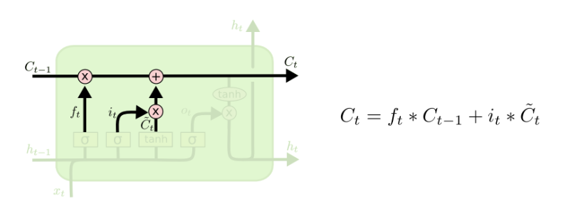
Long short-term memory Input gate: how much to input into our cell? / whether to write to cell g gate: how much to write to cell (how much to write into our cell?)
Intuition: “We’d want to add the gender of the new subject to the cell state to replace the old one we’re forgetting.”
Actually drop the information about the old subject’s gender and add the new information
https://colah.github.io/posts/2015-08-Understanding-LSTMs/

Slide 43
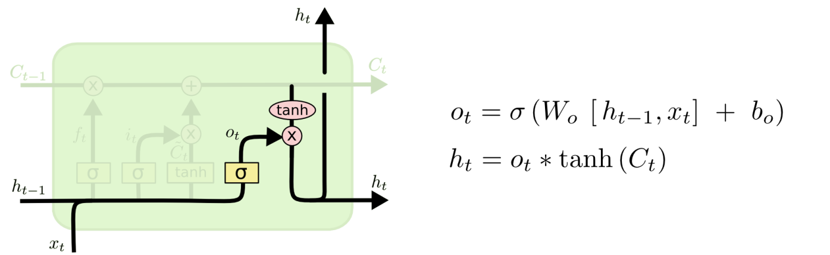
Long short term memory output gate: how much to reveal cell (how much to reveal from ourselves to the outside?
The output will be based on the cell state, but will be a filtered version.
Sigmoid: [0, 1]
tanh: [-1, 1]
Use the cell state to compute a hidden state which we will reveal to the outside world
Sigmoid: for each element of out cell state, do we want to reveal it or not?

Slide 44
Long short term memory output gate: how much to reveal cell (how much to reveal from ourselves to the outside?
Intuition: “For the language model example, since it just saw a subject, it might want to output information relevant to a verb, in case that’s what is coming next. For example, it might output whether the subject is singular or plural, so that we know what form a verb should be conjugated into if that’s what follows next”
https://colah.github.io/posts/2015-08-Understanding-LSTMs/

Slide 45
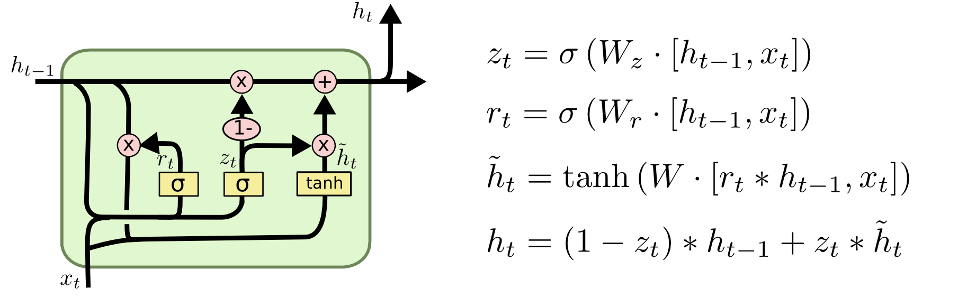
Lots of variations of LSTMs were proposed
Gated Recurrent Unit (GRU) – simplify the architecture of the LSTM

Slide 46
The Unreasonable Effectiveness of Recurrent Neural Networks
https://karpathy.github.io/2015/05/21/rnn-effectiveness/
Shakespeare
PANDARUS:
Alas, I think he shall be come approached and the day When little srain would be attain'd into being never fed, And who is but a chain and subjects of his death, I should not sleep.
Second Senator:
They are away this miseries, produced upon my soul, Breaking and strongly should be buried, when I perish The earth and thoughts of many states.
DUKE VINCENTIO:
Well, your wit is in the care of side and that. Second Lord: They would be ruled after this chamber, and my fair nues begun out of the fact, to be conveyed, Whose noble souls I'll have the heart of the wars.
Clown: Come, sir, I will make did behold your worship.
VIOLA: I'll drink it.

Slide 47
The Unreasonable Effectiveness of Recurrent Neural Networks
https://karpathy.github.io/2015/05/21/rnn-effectiveness/
Wikipedia
Naturalism and decision for the majority of Arab countries' capitalide was grounded by the Irish language by [[John Clair]], [[An Imperial Japanese Revolt]], associated with Guangzham's sovereignty. His generals were the powerful ruler of the Portugal in the [[Protestant Immineners]], which could be said to be directly in Cantonese Communication, which followed a ceremony and set inspired prison, training. The emperor travelled back to [[Antioch, Perth, October 25|21]] to note, the Kingdom of Costa Rica, unsuccessful fashioned the [[Thrales]], [[Cynth's Dajoard]], known in western [[Scotland]], near Italy to the conquest of India with the conflict. Copyright was the succession of independence in the slop of Syrian influence that was a famous German movement based on a more popular servicious, non-doctrinal and sexual power post. Many governments recognize the military housing of the [[Civil Liberalization and Infantry Resolution 265 National Party in Hungary]], that is sympathetic to be to the [[Punjab Resolution]] (PJS)[http://www.humah.yahoo.com/guardian. cfm/7754800786d17551963s89.htm Official economics Adjoint for the Nazism, Montgomery was swear to advance to the resources for those Socialism's rule, was starting to signing a major tripad of aid exile.]]

Slide 48
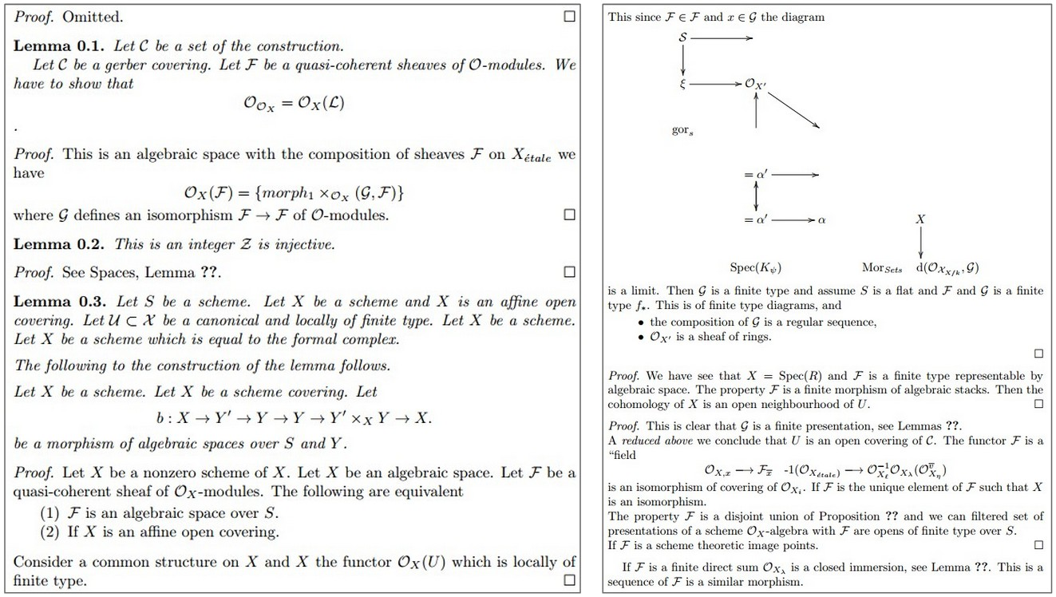
The Unreasonable Effectiveness of Recurrent Neural Networks

Slide 49
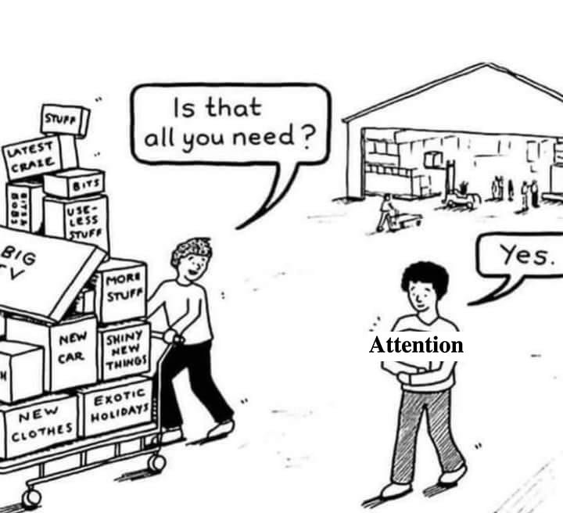
Attention is all you need
https://arxiv.org/abs/1706.03762

Slide 50
Self-attention

Slide 51

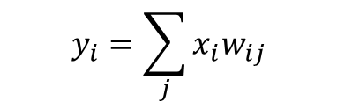


Self attention
y1
y2
y3
y4
y5
y6
y7
y8
$$y_{i}=\sum_{j}{{x_{i}w}_{ij}}$$
Self attention
$$w_{ij}^{′}=x_{i}^{T}x_{j}$$
$$w_{ij}^{ }=softmax(w_{ij}^{′})$$
$$W^{′}=X^{T}X$$
$$W^{ }=softmax(W′)$$
X - (b,t,k)
b – batch size
t – sequence length
k – embedding dim
$$Y^{ }=WX^{T}$$
x1
x2
x3
x4
x5
x6
x7
x8

Slide 52
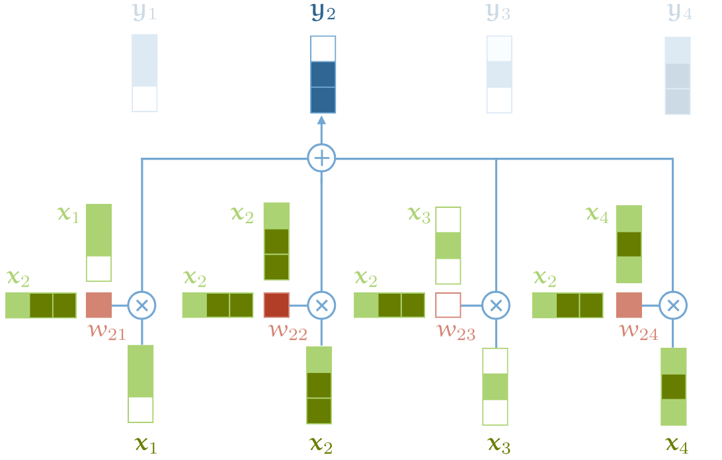
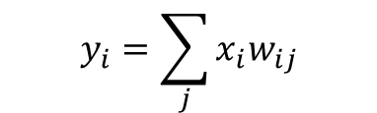
Self attention
$$y_{i}=\sum_{j}{{x_{i}w}_{ij}}$$
$$w_{ij}^{′}=x_{i}^{T}x_{j}$$

Slide 53
Self attention – so far
Has no parameters
It can look far back into the input sequence (every input has the same distance to every output)
It operates on sets (no information about the sequential structure of the input)
self_attention(permute(x)) =permute(self_attention(x))

Slide 54
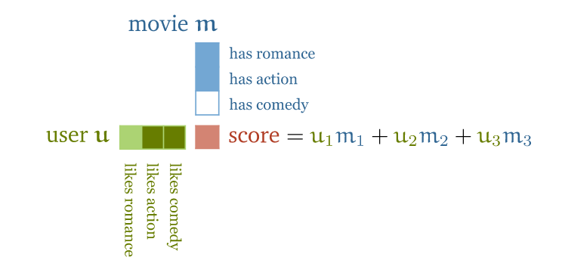
Self attention
http://peterbloem.nl/blog/transformers

Slide 55
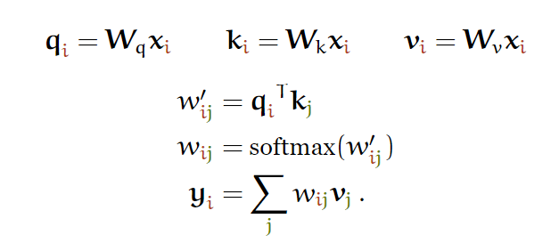
Attention: query, keys and values
“An attention function can be described as mapping a query and a set of key-value pairs to an output, where the query, keys, values, and output are all vectors.”

Slide 56
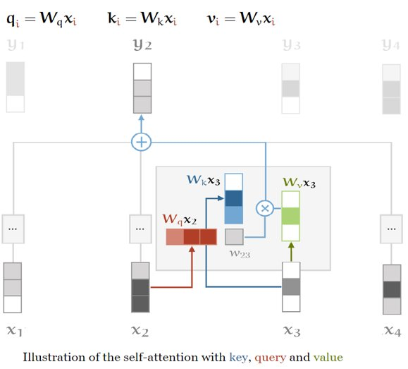
Key, query and values
To obtain the query, keys and values, there matrices are introduced: W_{q}, W_{k}, W_{v} (added some learnable parameters)

Slide 57
Key, query and values
key
query
value
When computing y_{i}, x_{i} is matched against every other input

Slide 58
Key, query and values
key
query
value
The vector that the query is matched against

Slide 59
Key, query and values
key
query
value
Used in the weighted sum of the output

Slide 60
Soft version of a dictionary
my_dict = {‘key1’: 24, ‘key2’: 1, ‘key3’: 6}
my_dict[key1] == 24
key
value
query

